Slide 1
Machine Learning Landscape & Python Basics

Slide 2
Learning Objectives
Introduction to Machine Learning
Introduction to Python
Installation Steps
Data Types in Python
Numpy
Pandas
Case Study
2

Slide 3
Introduction to Machine Learning
Machine learning is a field of computer science that uses statistical techniques to give computer systems the ability to "learn" (e.g., progressively improve performance on a specific task) with data, without being explicitly programmed.
3

Slide 4
Introduction to Data Science
Descriptive Statistics
Understand data
Insights on central values, spread, distribution
Inferential Statistics
Establish reliability of identified pattern (statistical significance)
Analytics: Descriptive analytics
Diagnostic Analytics
Predictive
Prescriptive

Slide 5
Types of Machine Learning
Supervised Learning
Clearly defined X and Y variables
Predict a continuous response (Regression) or categorical response (classification)
Unsupervised Learning
Unlabelled data
Emerging patterns based on similarity identified
Customer segmentation
Market basket analysis
Reinforcement Learning
taking suitable action to maximize reward in a particular situation
to find the best possible behavior or path it should take in a specific situation
Self driving cars, traffic light control, robotics

Slide 6
Supervised learning vs Reinforcement Learning
In supervised learning the training data has the answer key with it so the model is trained with the correct answer itself
In reinforcement learning, there is no answer but the reinforcement agent decides what to do to perform the given task.
In the absence of training dataset, Reinforcement learning learns from its experience.

Slide 7
Machine Learning in real life
Detecting credit card frauds
Loan default prediction
Election campaigning strategies based on sentiment analysis
Recommendation engines in e-commerce sites
Predictive text suggestion in smartphones
Image recognition
Chatbots & conversational AI

Slide 8
Python ( What and Why ?)
Python is the most popular programming language & choice for Data Scientist / Data Engineer across the world
Very rich libraries & functions
Community support
Easy to deploy in production
Support for all the new state of the art technologies ( like deep learning)
8

Slide 9
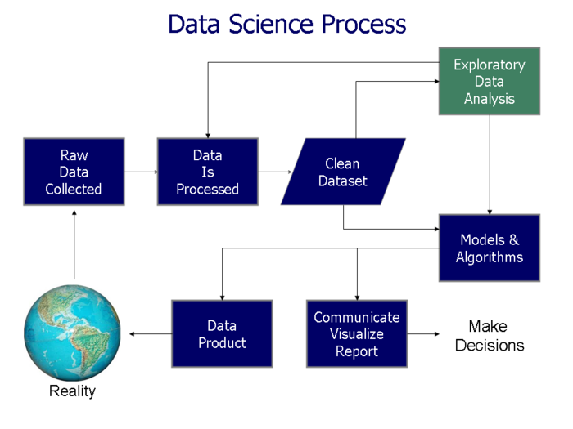

Slide 10
Installation Steps
Install using the instruction given in the below links - 1. Install Jupyter - http://jupyter.org/install Preferred installation method is through Anaconda distribution.
Install Python 3.6 version. 2. Anaconda 5.2 For Linux Installer - https://www.anaconda.com/download/#linux 3. Anaconda 5.2 For macOS Installer - https://www.anaconda.com/download/#macos 4. Anaconda 5.2 For Windows Installer - https://www.anaconda.com/download/#windows (You need to download the version compatible with your OS)
10

Slide 11
Common python libraries
NumPy – handling multi-dimensional arrays
Scipy – Statistical package
Matplotlib, seaborn – Visualisation
Pandas – handling arrays & dataframes

Slide 12
Types of common variables
Integer
Float
String
Logical

Slide 13
Data Types in Python
Apart from data types like int, string, float Python has the below data types which are very useful for data science -
List
Tuples
Dictionaries
13

Slide 14
Python data structures - List vs Tuple vs Dictionary
Both list & tuples are ordered sequence of objects
Both can contain mixed data types
List is mutable while a tuple is like a list but immutable
Tuples are faster and consume less memory
Dictionary list of items in terms of a key and a value

Slide 15
Numpy
NumPy is the fundamental package for scientific computing with Python.
It contains -
a powerful N-dimensional array object - ndarray
sophisticated (broadcasting) functions
useful linear algebra, Fourier transform, and random number capabilities etc.
Refer - http://www.numpy.org/

Slide 16
Pandas
A library written for the Python programming language for data manipulation and analysis.
In particular, it offers data structures and operations for manipulating numerical tables and dataframes.

Slide 17
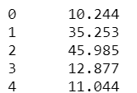
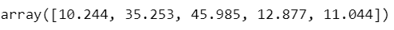
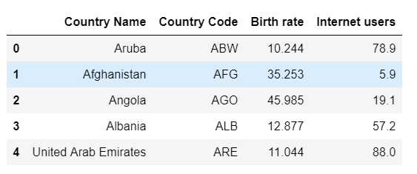
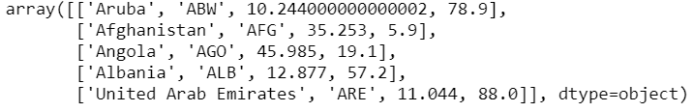
Practical example of the usage of dataframe, series & array on a dataset
Extract Birth rate as Pandas Series
Demographic data
Country Name | Birth rate | Internet users | Income Group
Aruba | 10.244 | 78.9 | High income
Afghanistan | 35.253 | 5.9 | Low income
Angola | 45.985 | 19.1 | Upper middle income
Albania | 12.877 | 57.2 | Upper middle income
United Arab Emirates | 11.044 | 88 | High income
Convert to dataframe
Extract birth rate as numpy array
Convert dataframe to numpy array

Slide 18
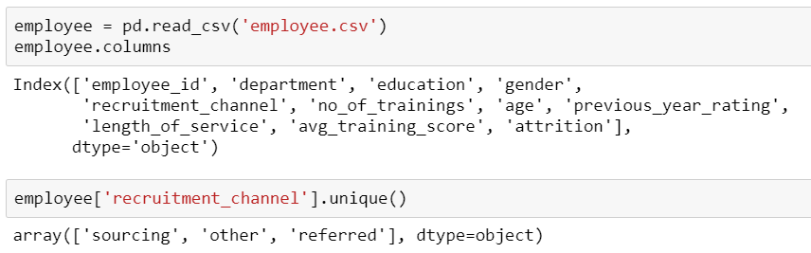
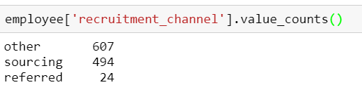
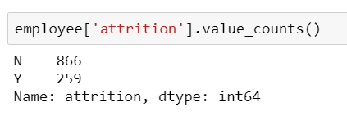
Typical use cases for unique & valuecount
Mainly used in understanding proportions of levels of a categorical variable
value_count – proportion of employees recruited from each recruitment source
unique - What are the sources of recruitment in the dataset
value_count – proportion of attrition in a dataset

Slide 19
Typical use cases of a python dictionary
Use whenever a mapping from a key to a value is required
mapping a field Unique ID to their human-friendly labels
dictionary of genres in a movie database
Sentiment analysis
{'id': 28, 'name': 'Action'}, {'id': 35, 'name': 'Comedy'}, {'id': 10402, 'name': 'Music'}, {'id': 10751, 'name': 'Family'}, {'id': 12, 'name': 'Adventure’}
based on dictionary of positive & negative words

Slide 20
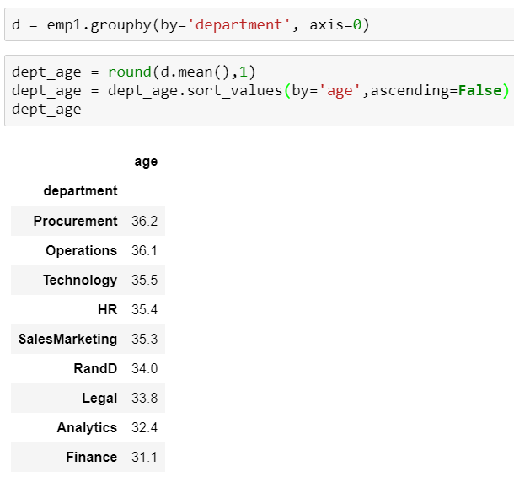
Application of group by
Similar to pivot tables in excel
What is the average age of employees in each department in the employee dataset?
What is the highest rating a movie has received in the genre “comedy”?

Slide 21
Merge vs Join
Merge – merges 2 df using a unique column identifier (primary key)
Join – to join 2 dataframes by the index

Slide 22
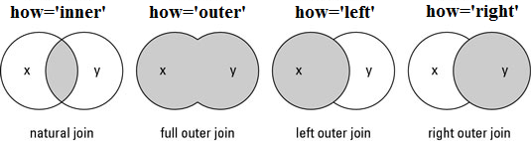
Types of merge
Natural join - Intersection
Full outer join - Union
Left outer join
Right outer join
To keep only rows that match from the data frames, specify the argument how=‘inner’.
To keep all rows from both data frames, specify how=‘outer’.
To include all the rows of your data frame x and only those from y that match, specify how=‘left’.
To include all the rows of your data frame y and only those from x that match, specify how=‘right’.

Slide 23
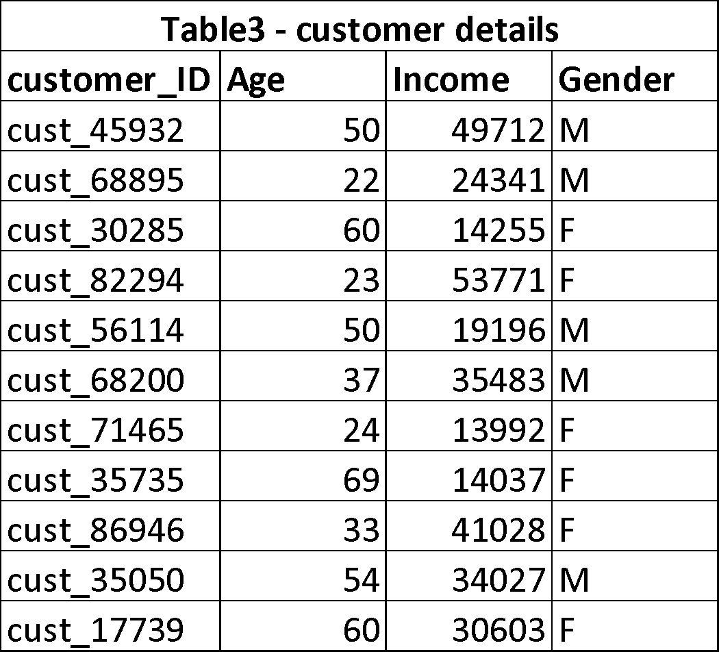
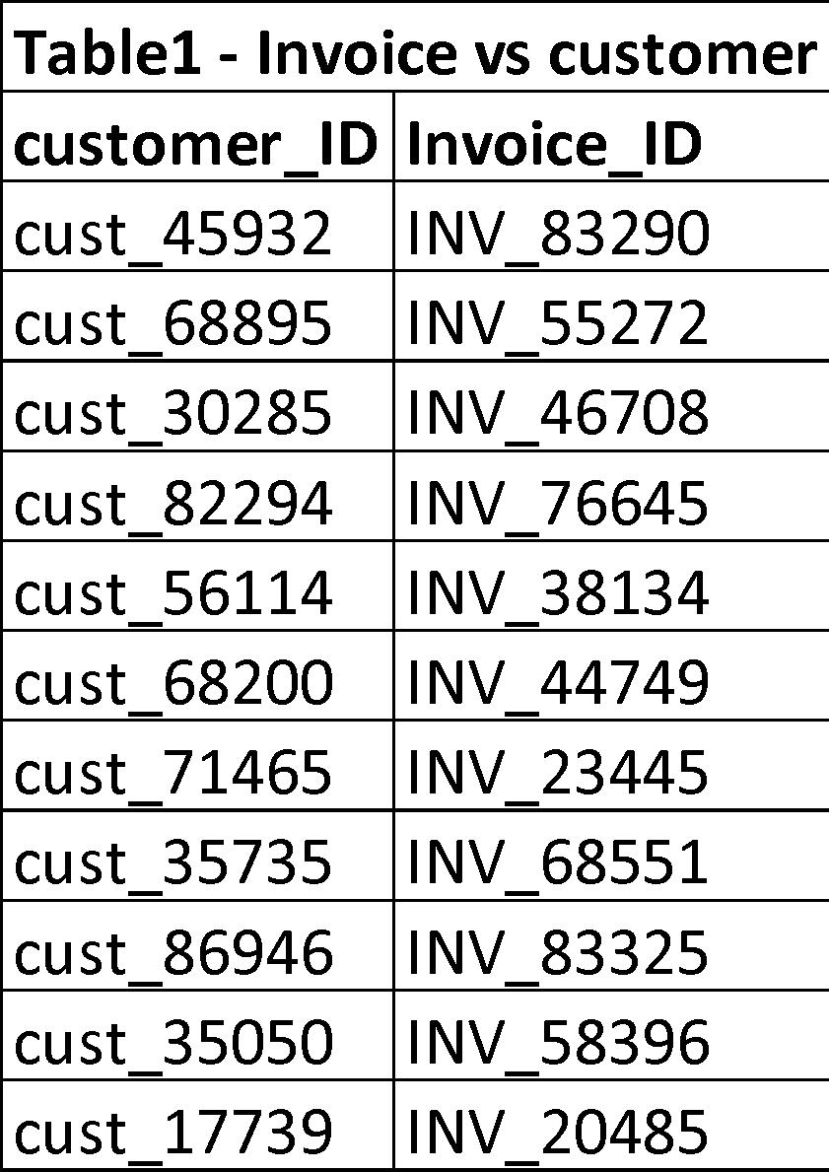
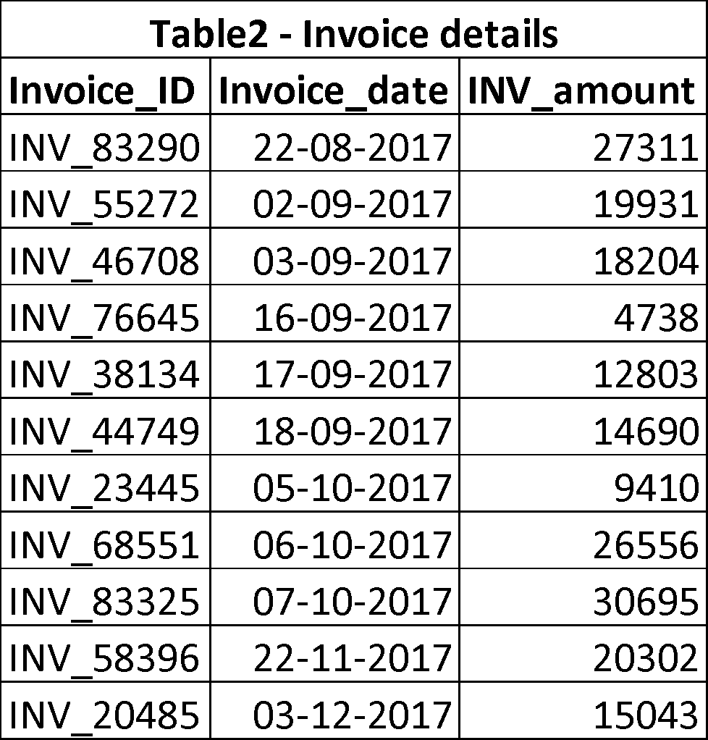
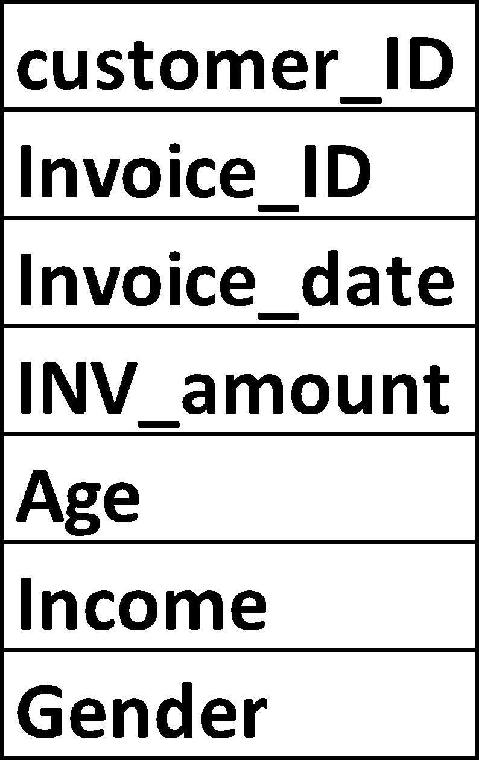
Uses of Merge & Join
Create a transactional dataframe per customer to analyse purchasing patterns according to customer demography

Slide 24
Case Study
Uber Drive Data Analysis -
The data of a driver’s uber trips are available for year 2016.
Your manager wants you to explore this data to give him some useful insights about the trip behaviour of a Uber driver.
Dataset -
The dataset contains Start Date, End Date, Start Location, End Location, Miles Driven and Purpose of drive (Business, Personal, Meals, Errands, Meetings, Customer Support etc.)

Slide 25
Steps
1. Import the libraries 2.Get the data and observe it 3.Check missing values, either remove it or fill it. 4.Get summary of data using python function. 5.Explore the data parameter wise Here we have information of destination(start and stop), time(start and stop), category and purpose of trip, miles covered.

Slide 26
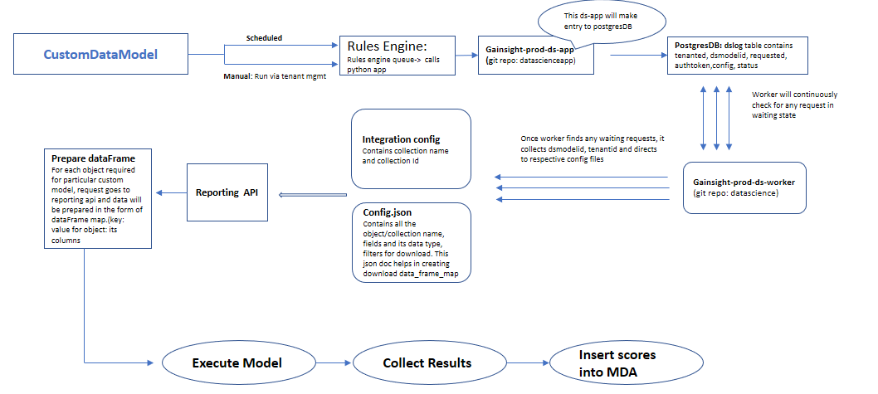
Industry Applications

Slide 28
Insights Consumption
Actionable insights(Reason code)
Model Deployment
Model schedular
Requirement Gathering,
Business understanding
Problem definition
Data Collection
Initial Data understanding & Profiling
Questionnaires based on received dataset
EDA
Data cleansing, Preprocessing, pattern and behavior understanding
Feature Engineering
Feature building
Feature selection
Model building and evaluation
Training, testing, tuning of model

Slide 29


Questions?

